Slide 1
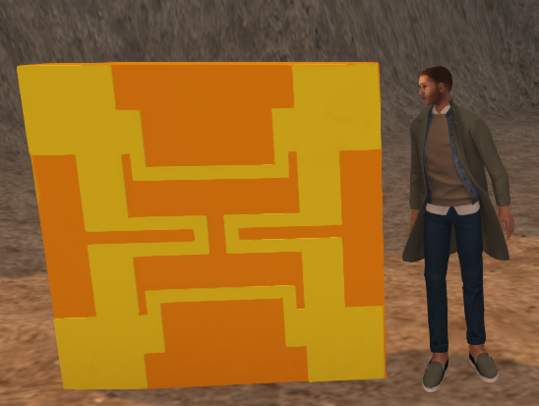
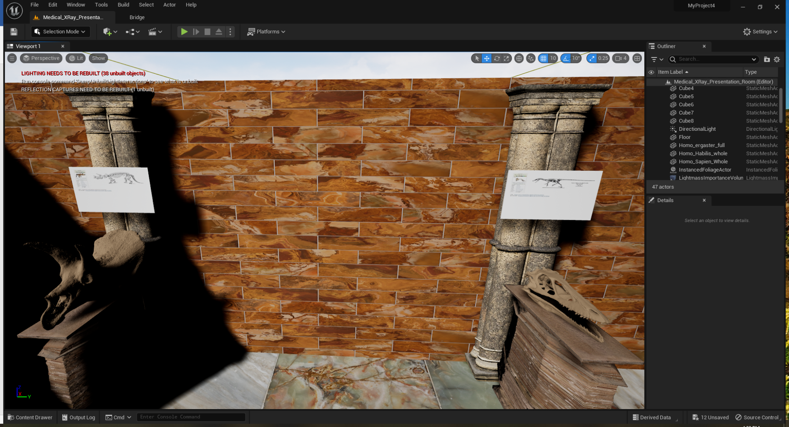
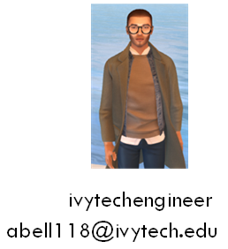
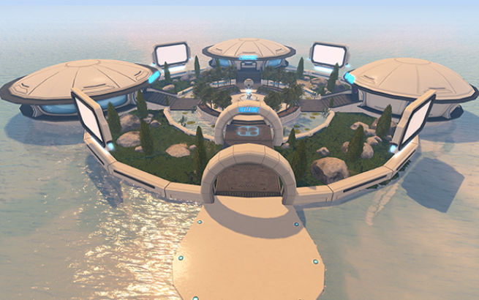
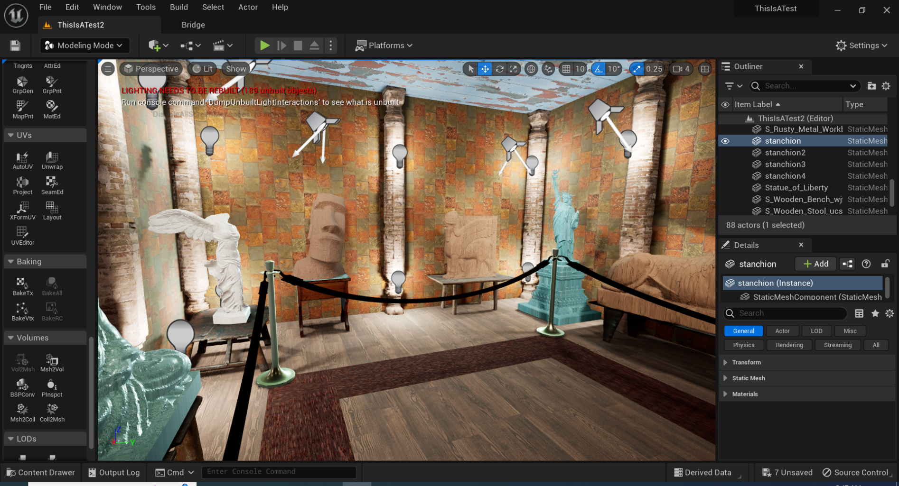
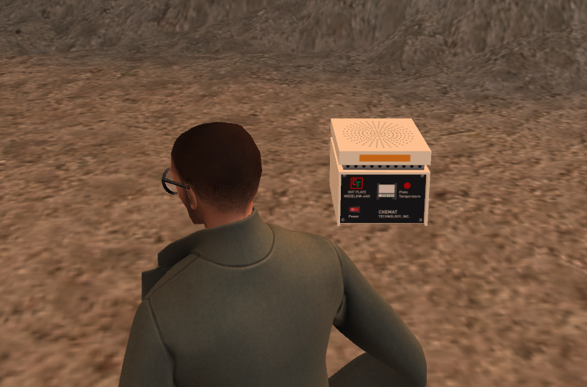
Developing VR Resources to support MEMS Education
Andrew Bell - Ivy Tech Community College
BCC, FCC and HCP Unit Crystal Cells in Second Life
SCME Pressure Sensor & me
Abstract
Second Life (using computers)
Unreal Engine (Oculus Quest II)
Blender and Solidworks
Conclusion & References
Using VR in education has been proposed as a way to enhance student learning by presenting material in a virtual format. Objects and environments can be built and uploaded to virtual platforms like Second Life, Unity, Unreal Engine, etc. The objects designed for the virtual worlds can be created using Maya, Blender, Solidworks, etc. Linkage to multiple software tools can result in greater collaboration between engineering, visual communication, and design technology students which improves the real-world skills of everyone.
The first VR software package environment selected was Second Life. This package allows the user to buy land and build virtual environments which can be shared with everyone.
In 2020 we purchased an island and IvyTech Engineering Island was born. It used a pre-fab set of buildings and is located at http://maps.secondlife.com/secondlife/IvyTech%20Engineering%20Island/207/120/21
Students can access the island and create their avatars using the free Second Life Viewer. More information can be found @
https://www.ivytechengineering.com/SecondLife/
Over 100 posters created by students have been posted on the IvyTech Engineering Island.
Games were developed and buildings were created, bought, and added.
In the summer of 2023, I took a class on Unreal Engine 5.0. This class was an introduction and was offered as a self-paced course by Kentucky Community & Technical College System (KCTCS). All material was offered in a Google Drive and included nine lessons with homework. It took about a month to get approval and install all the software needed. The learning curve is very steep.
Some models could be downloaded from an STL library like GrabCAD or Thingiverse but need to be aware of the mesh size before using. You can also use Quixel Bridge for models.
The creation of objects or game assets appears to be a key obstacle to the development of any VR environment,
Solidworks is currently taught in many colleges and the use of this tool can be capitalized on for object creation by students.
Blender can be used to convert STL files into FBX files for Unreal Engine or DAE files for Second Life. Maya models can also be imported into Blender and converted for Unreal Engine or Second Life.
Truss models created in Solidworks uploaded
DC Motor Animation and model uploaded
BCC, FCC, and HCP models created and uploaded
Pressure Sensor created and uploaded
Working on uploading SCME cleanroom equipment
Building and using VR for MEMS education is a great fit but the learning curve. VR development will require the use of multiple software packages and your computer will need to be able to support high-end graphics. The potential for VR is almost endless.
1.) 2019 HI-TEC Conference - Creating Solidworks Model for SCME Pressure Sensor
https://www.ivytechengineering.com/abell118/files/Creating%20Solidworks%20Model%20for%20SCME%20Pressure%20Sensor.pdf
2.) 2021 MNTeSIG Conference - Building Virtual World in Second Life for MEMS Education
https://www.ivytechengineering.com/abell118/files/Building%20Virtual%20World%20in%20Second%20Life%20for%20MEMS%20Education.pdf
3.) 2022 MNTeSIG Conference - Building Virtual World in Second Life for MEMS Education (update)
https://www.ivytechengineering.com/abell118/files/Building%20Virtual%20World%20in%20Second%20Life%20for%20MEMS%20Education%20-%20update.pdf
4.) 2022 HI-TEC Conference - Rebuilding Lost Virtual Educational Worlds using Solidworks, Blender and Second Life
https://www.ivytechengineering.com/abell118/files/Rebuilding%20Lost%20Worlds%20Rev%20B.pdf
5.) 2022 VWBPE Conference - Virtual Reality and Its Use in Education
https://www.ivytechengineering.com/abell118/files/Virtual%20Reality%20and%20its%20Use%20in%20Education.pdf
Andrew Bell @ ivytech.edu
Objectives & Software
This poster will describe some of the lessons learned in developing course content for engineering courses.
1.) Cost & availability
2.) Sharing objects & support
3.) Software Learning curves
Software used for AR/VR Development
1.) Unreal Engine or Second Life
2.) Solidworks or 3D CAD program
3.) Maya or Blender
4.) SideQuest, Oculus App, Meta Quest Developer Hub, Visual Studio, Epic Game Launcher, and a computer with NVIDIA GTX 1050 Ti / AMD Radeon RX 470 or greater

